Slide 1

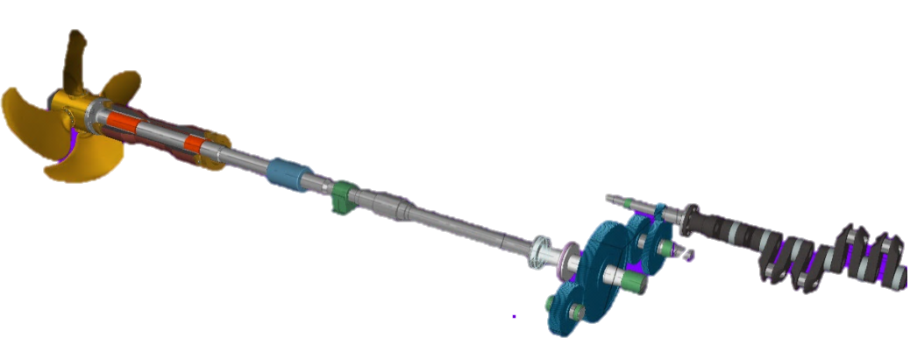
CAD-CAM
STRUCTURAL DESIGN
NOZZLE ADAPTATION
BULB DESING
CONSTRUCTIONS
MODIFICATIONS
YACHT DESIGN– MONOHULL – CATAMARAN
LIGHT CRAFT– TUGBOATS – FISHING BOAT - BARGE
NAVAL ARCHITECTURE
STRUCTURE OPTIMIZATION
VIBRATION ANALYSIS
3D MODELING
NOISE & INSULATION CALCULATION
PROPULSION SYSTEM DESIGN & OPTIMIZATION
PRODUCT ENGINEERING
ASSEMBLY
CUTTING DRAWINGS
www.tecnavin.com
e-mail: navser@gye.satnet.net

Slide 2
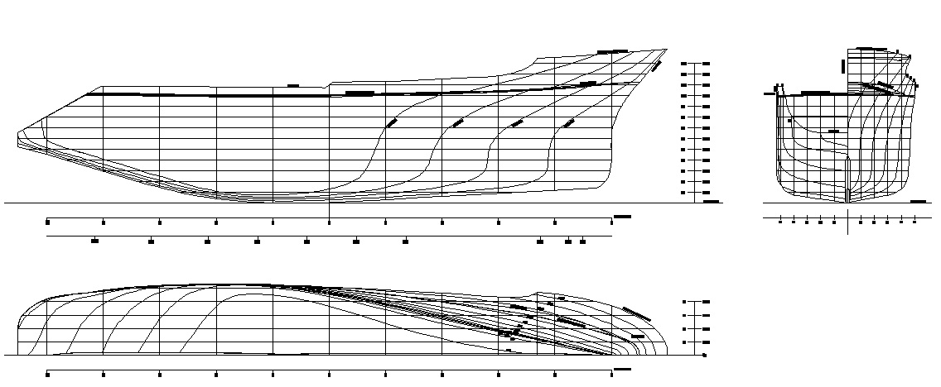
PRELIMINARY DESIGN
General arrangement drawing
General arrangement drawings
Basic Structure calculation applying Lloyd’s Register software
Basic Structure drawings
Basic circuit drawings
3D model including hull, superstructure and outfitting
e-mail: navser@gye.satnet.net

Slide 3
PRELIMINARY DESIGN
Preliminary Structure Drawing
General arrangement drawings
Basic Structure calculation applying Lloyd’s Register software
Basic Structure drawings
Basic circuit drawings
3D model including hull, superstructure and outfitting
e-mail: navser@gye.satnet.net

Slide 4
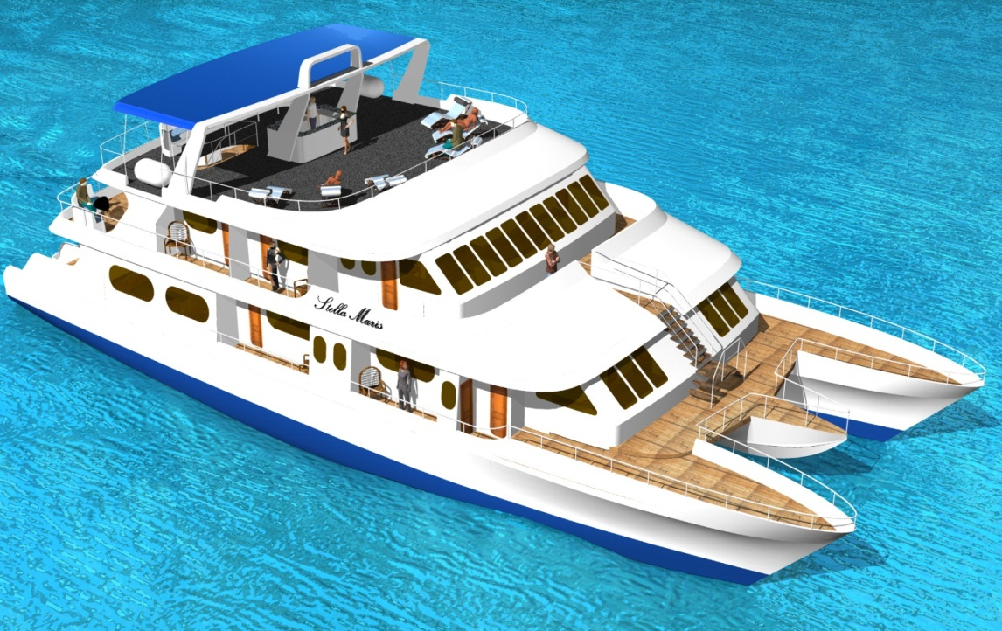
PRELIMINARY DESING
3D Model
General arrangement drawings
Basic Structure calculation applying Lloyd’s Register software
Basic Structure drawings
Basic circuit drawings
3D model including hull, superstructure and outfitting
e-mail: navser@gye.satnet.net

Slide 5
BASIC DESIGN
Complete Structural Calculation applying Lloyd’s Register software and using IACS recommendations
Detail Structure drawings.
-Entire Frames
-Bulkheads
-Longitudinal section
-Decks
e-mail: navser@gye.satnet.net

Slide 6
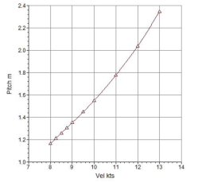
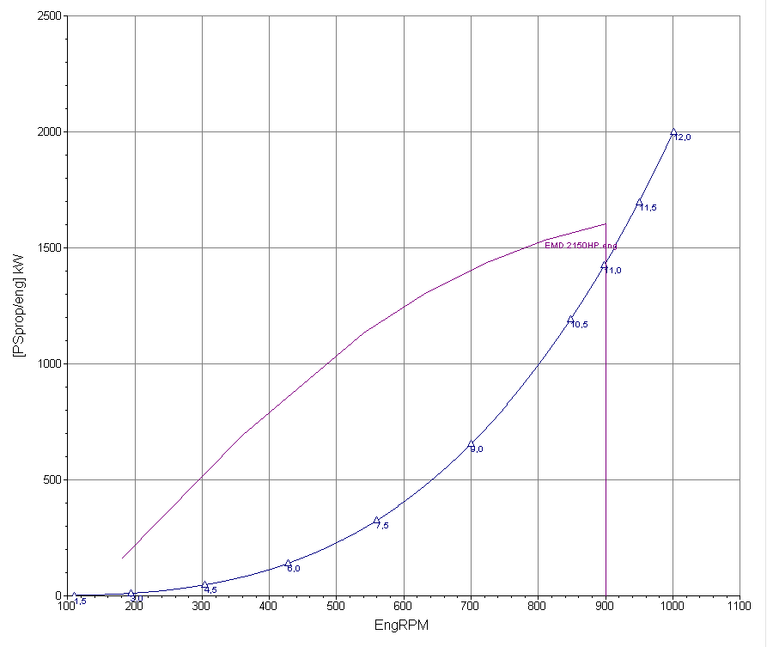
PROPULSIVE CALCULATION
Propulsion System Estimation. Propeller-gearbox selection
Speed and Power estimation
Propeller & offset drawing design
Estimation of added mass variation in CPP propellers
e-mail: navser@gye.satnet.net

Slide 7
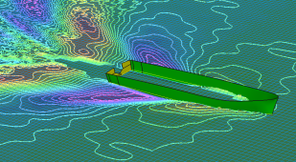
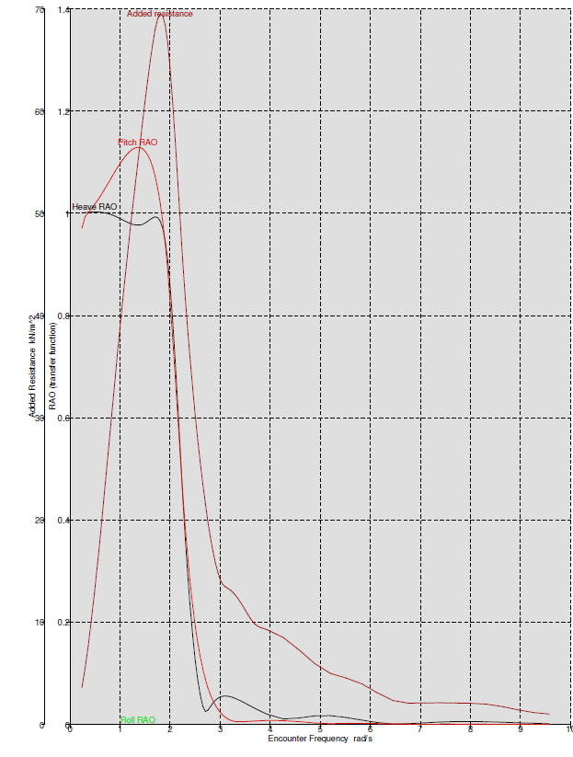
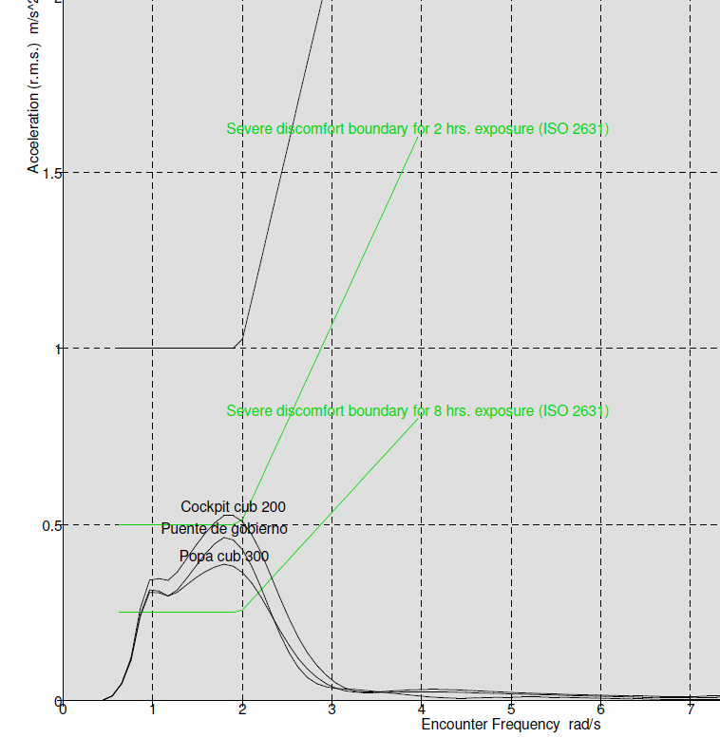
HYDRODYNAMIC
Simulation and estimation of sea behavior parameters
Seakeeping MSI & RAO
Hydrodynamic Analysis for
Line forms and Resistance Optimization
RAO Curves
MSI Curves
e-mail: navser@gye.satnet.net

