Slide 1

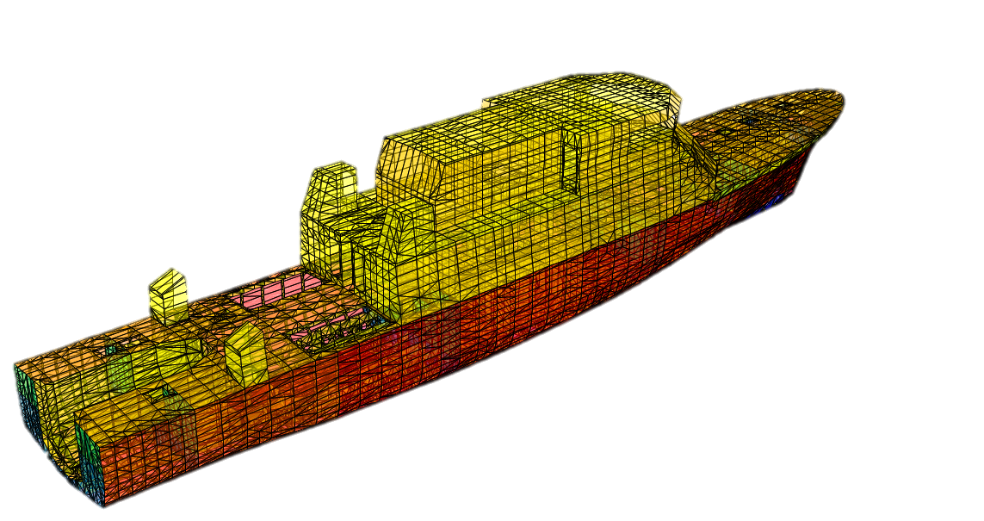
FINITE ELEMENT MODELS
Strucutral Optimization
Natural and Forced Vibrational Calculation on beam-hull
Complete FEM model for beam-hull and Structure Optimization
e-mail: navser@gye.satnet.net

Slide 2
DETAIL FINITE ELEMENT MODELS
Structural Optimization of vessel parts
Definition of details for equipment installation
Detail analysis on Structural part of vessel
e-mail: navser@gye.satnet.net

Slide 3
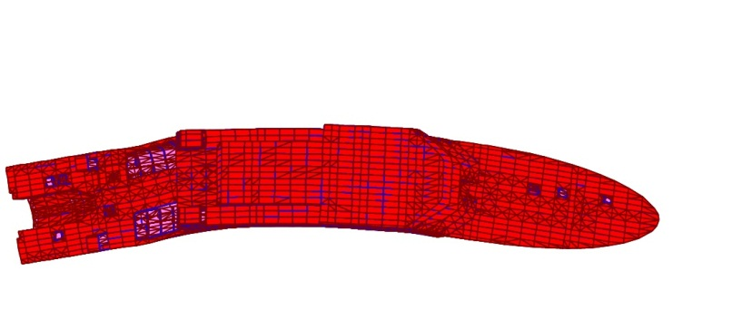
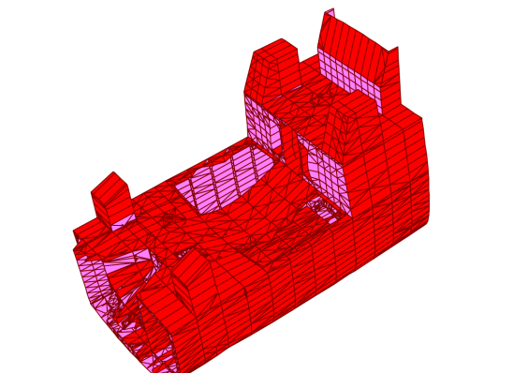
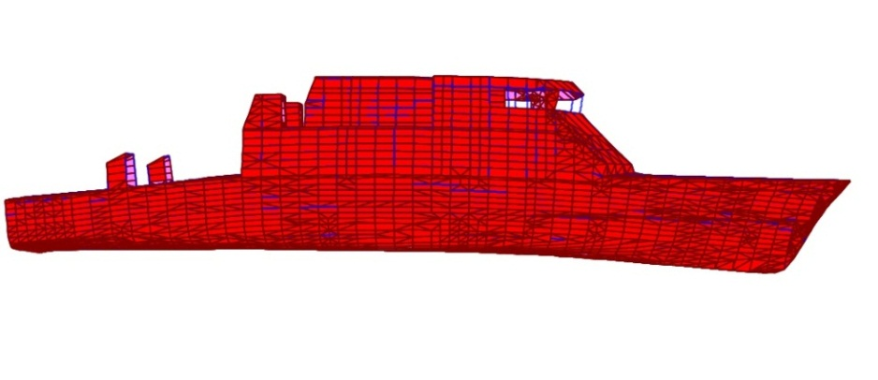
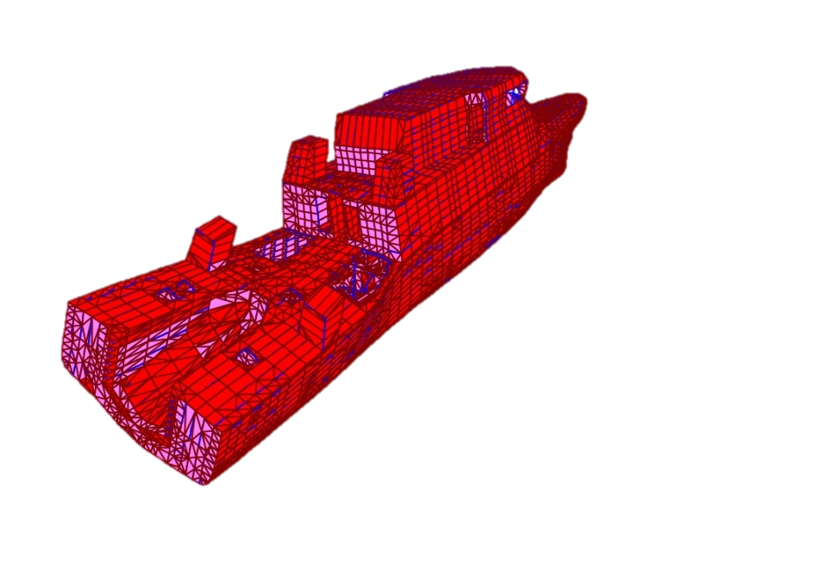
VIBRATION ANALYSIS
Global and local Frequencies on Ship
Natural y Forced Vibrational Calculation of hull-girder
Natural frequencies are analyzed, verifying not to overlap each other on ship operational range, in order to avoid Structural fails
First Horizontal Vibration Mode
First Vertical Vibration Mode
Deck Natural Frequency
First Transverse Vibration Mode

