Slide 1

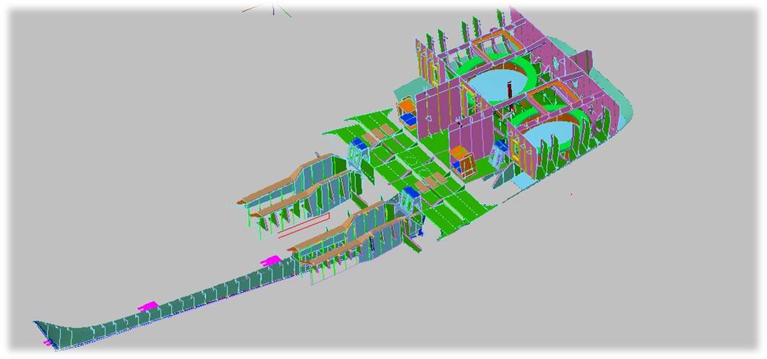
PRODUCT ENGINEERING TOOLS
Hull and superstructure 3D Structural model
Assembly drawings
  Assembly sequence using encoded pieces and drawings.
Nesting & Cutting Codes (CNC)
3D MODEL
It allows exactitude on:
- Materials and pieces control
- Weight and centroids Estimation
- Cost estimation
“Provide tools in order to achieve a high quality and Productive Construction with better Control on wasted material during construction”
e-mail: navser@gye.satnet.net

Slide 2
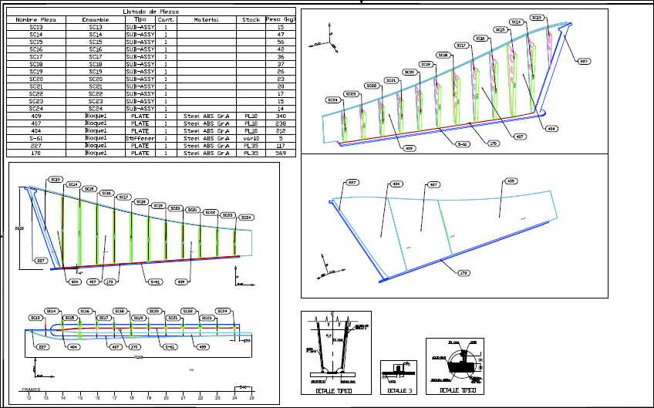
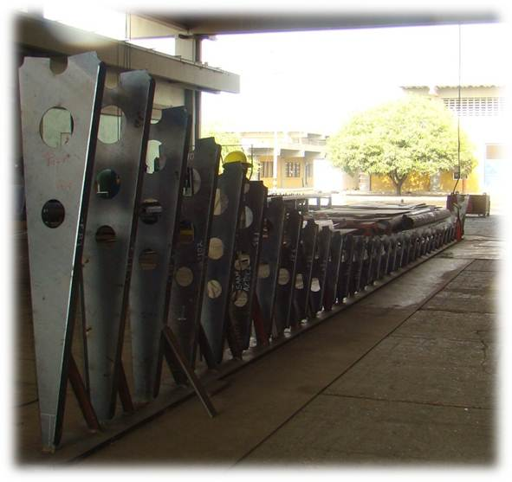
PRODUCT ENGINEERING TOOLS
Hull and superstructure 3D Structural model
Assembly drawings
  Assembly sequence using encoded pieces and drawings.
Nesting & Cutting Codes (CNC)
ASSEMBLY DRAWINGS
Assembly Sequence using encodes drawings and pieces which ease the prefabrication, control, and precise construction
“Provide tools in order to achieve a high quality and Productive Construction with better Control on wasted material during construction”
e-mail: navser@gye.satnet.net

Slide 3
PRODUCT ENGINEERING TOOLS
Hull and superstructure 3D Structural model
Assembly drawings
  Assembly sequence using encoded pieces and drawings.
Nesting & Cutting Codes (CNC)
NESTING & CUTTING CODES (CNC)
It allows exactitude on automated pieces cutting and wasted material reduction
“Provide tools in order to achieve a high quality and Productive Construction with better Control on wasted material during construction”
e-mail: navser@gye.satnet.net

